Slide 1
IF.99.1 Advanced Algorithms
Fall 2017

Slide 2
International Olympiad in Informatics
International contest for Programmers under the age of 19 years
HTL Leonding won already several medals
Austrian competition
Last year: 3 participants out of 4 were from the HTL Leonding

Slide 3
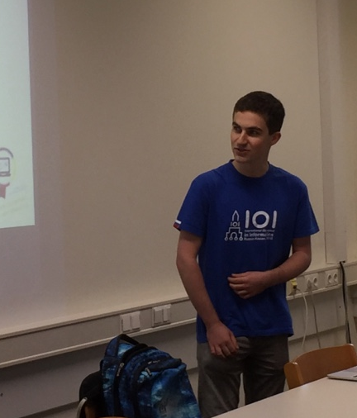
Event with Flo Leimgruber
2016 graduate of our school
Two-times bronze medal winner at the IOI
Date: Friday, October 22
Friday 8 – 10: IF
Friday 10 – 12: ITM

Slide 4
Goal of Advanced Algorithms
Training camp for the
Austrian Olympiad in Informatics (AOI)
International Olympiad in Informatics (IOI)

Slide 5
Program
Recursion
Complete search
Greedy algorithm
Dynamic programming
Training, training, training

Slide 6
Administrivia
Possible meeting times for winter term 2017 and summer term 2018
Monday unit 8 and 9 or 9 and 10
Thursday unit 9 and 10
Tick your preferred time on the application form

Slide 7
One more Thing …

Slide 8
Save the Date
School or JKU (10:00 am or 2:00 pm)
Don’t forget to register on time

